Slide 1

Automatic Radiology Report Generation - A Case Study
Guided by:
Ms. Krishna S S
Assistant professor
Department of Computer Science
University of Kerala
Presented by:
Siyahul Haque T P
Reg No:97322607030
MSc Computer Science
Department of Computer Science
University of Kerala

Slide 2

Agenda
Introduction
Motivation
Challenges
Literature review
Dataset
Methodology
Evaluation Results
Conclusion
References
2

Slide 3
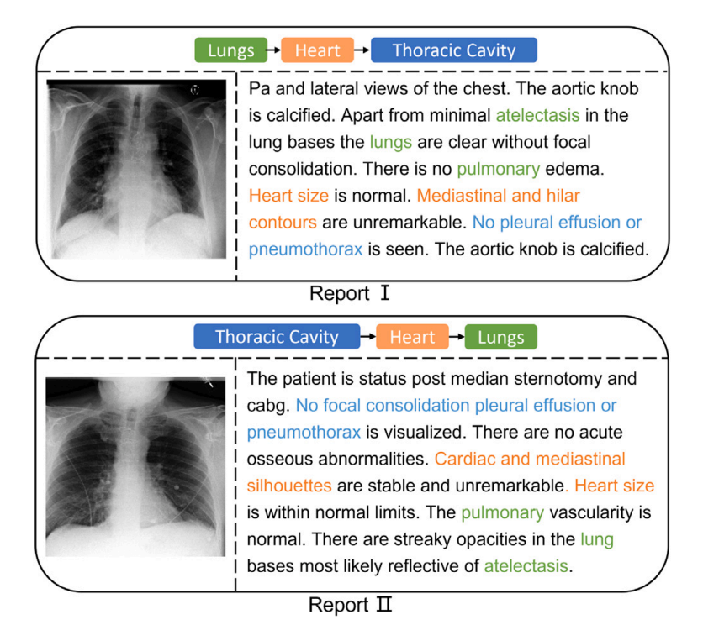
Introduction
Medical imaging technology has been widely used in various diagnosis and treatment scenario
Medical professionals use X-Rays to detect anomalies
Automated radiology report generation solution can be used as a supportive tool to lower the burden on radiologists
Pa and lateral views of the chest. The aortic knob I is calcified. Apart from minimal atelectasis in the lung bases the lungs are clear without focal | consolidation. There is no pulmonary edema. Heart size is normal. Mediastinal and hilar contours are unremarkable. No pleural effusion or pneumothorax is seen. The aortic knob is calcified.
Fig.1
3

Slide 4
Motivation
Diagnosing using x-rays (Eg: CXRs) needs expert knowledge and can be time-consuming.
Composing an accurate and comprehensive medical report is a skillful job that requires sufficient medical knowledge and extensive diagnostic experience
Writing reports takes up a lot of the energy of the physicians (about 10 min or more on average) (Yang et al., 2022)
4

Slide 5
Challenges
Image Understanding and Interpretation
Clinical Context and Knowledge
Natural Language Processing (NLP)
Data Privacy and Security
5

Slide 6
Literature Review
TITLE | AUTHOR | YEAR | JOURNAL/CONFERENCE | DATASET | METHOD
Automated radiology report generation using conditioned transformers | Omar Alfarghaly, Rana Khaled,Abeer Elkorany, Maha Helal, Aly Fahmy | 2021 | Informatics in Medicine Unlocked | IU-XRay | CDGPT2
Transformers in medical imaging: A survey | Fahad Shamshad, Salman Khan , Syed Waqas Zamir, Muhammad Haris Khan, Munawar Hayat, Fahad Shahbaz Khan , Huazhu Fu | 2023 | Medical Image Analysis | IU-XRay MIMIC-CXR | CNN,ViT
6

Slide 7
Cntd…
METHOD
TITLE | AUTHOR | YEAR | JOURNAL/CONFERENCE | DATASET | METHOD
Improving chest X-ray report generation by leveraging warm starting | Aaron Nicolson, Jason Dowling, Bevan Koopman | 2023 | Artificial Intelligence in Medicine | MIMIC-CXR | CvT2DistilGPT2
A scoping review on multimodal deep learning in biomedical images and texts | Zhaoyi Sun, Mingquan Lin, Qingqing Zhu, Qianqian Xie, Fei Wang, Zhiyong Lu , Yifan Peng | 2023 | Journal of Biomedical Informatics | IU-XRay MIMIC-CXR CheXpert | CNN,LSTM
7

Slide 8
Dataset
To evaluate the effectiveness of TranSQ, we make comprehensive experiments on two well-known medical report generation benchmarks
MIMIC-CXR
IU X-RAY
8

Slide 9
MIMIC-CXR
Dataset is available in two versions which are only differ in size and the image quality.
MIMIC-CXR Dicom version (4.6 TB)
MIMIC-CXR JPG version (557.6 GB)
Contain 377,110 Chest X-ray images corresponding to 227,835 radiographic studies
Each study contains frontal and lateral views of the chest
Each study consists of a report with an examination, indication, technique, findings, and impression for each CXR
9

Slide 10
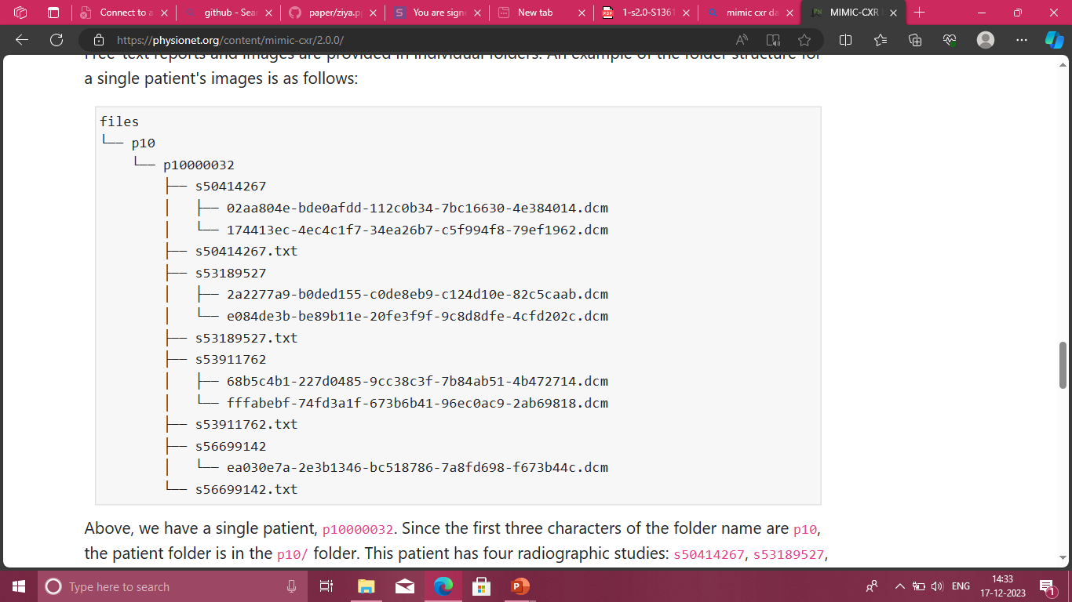
Folder Structure – mimic cxr
10

Slide 11
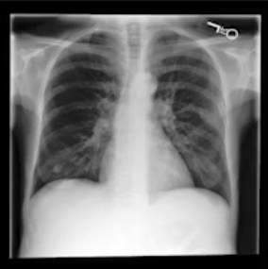
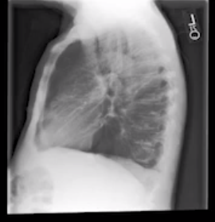
Sample CXR Image And Corresponding Report
FINAL REPORT
EXAMINATION: CHEST (PA AND LAT)
INDICATION: F with new onset ascites // eval for infection
TECHNIQUE: Chest PA and lateral
COMPARISON: None.
FINDINGS:
There is no focal consolidation, pleural effusion or pneumothorax. Bilateral nodular opacities that most likely represent nipple shadows. The cardiomediastinal silhouette is normal. Clips project over the left lung, potentially within the breast. The imaged upper abdomen is unremarkable. Chronic deformity of the posterior left sixth and seventh ribs are noted.
IMPRESSION:
No acute cardiopulmonary process.
Fig.2
11

Slide 12
IU X-RAY
IU X-RAY (Demner-Fushman et al., 2016) is a Chest X-ray dataset collected and organized by Indiana University in the United States.
It includes 7470 medical images and 3955 radiology reports, in which each medical report strictly corresponds to two Chest X-ray images.
Consistent with previous work (Li et al., 2018, 2019; Chen et al., 2020; Jing et al., 2020), the dataset is split into training, validation, and testing sets with a ratio of 7:1:2.
IU X-RAY JPG version (35 GB)
12

Slide 13
Methodology
According to the doctors’ thinking logic , the process of writing a medical report can be divided into three main tasks:
Visual properties Understanding: to observe and understand the visual representation of images;
Intention-based observation: to form the observation intention of the images and find the corresponding visual properties and their region from the image;
Description generation: to describe the observation results into sentences to form the diagnosis report.
13

Slide 14
Model
The model includes three modules:
Visual Extractor
Semantic Encoder
Report Generator
14

Slide 15
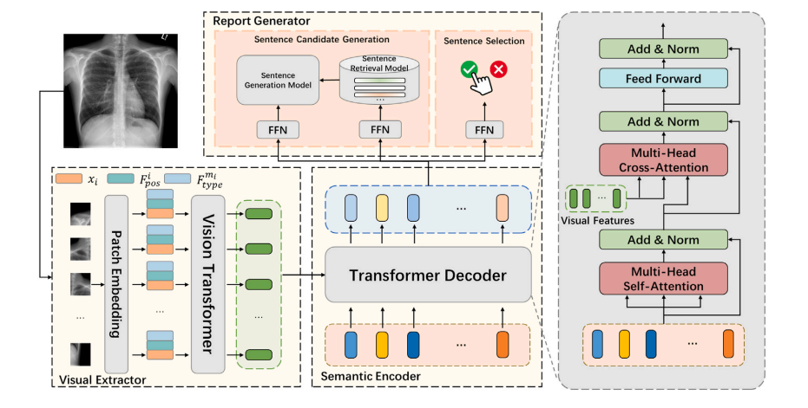
Fig.3
15

Slide 16
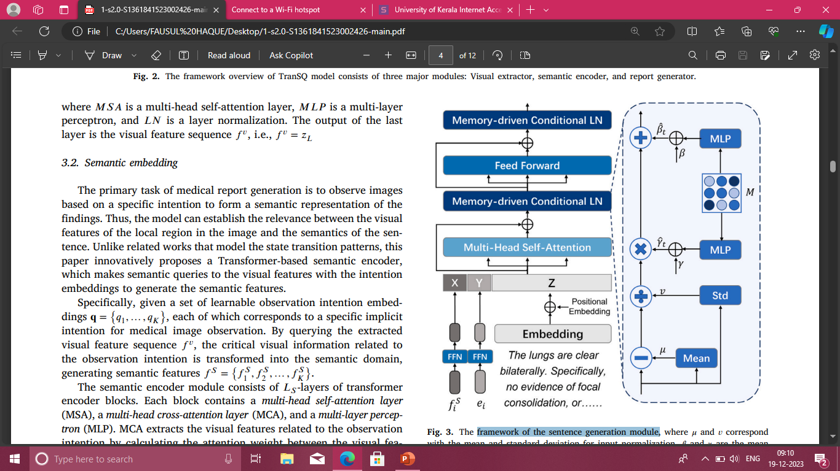
Framework of The Sentence Generation Module
Fig.4
16

Slide 17
Visual Extractor
The visual extractor in the proposed model aims to convert input medical images into a sequence of visual features.
Initially, the images are resized, divided into patches, and mapped using linear projection, resulting in a patch embedding sequence.
Learnable spatial position embeddings and type embeddings are then added to distinguish positions and sources, with spatial embeddings expressing local region correlations and type embeddings representing relationships between different images.
Two types of type embeddings, order-based and view-based, are experimented with, and a combination of both yields optimal results.
17

Slide 18
Cntd…
The visual encoder, based on ViT (Vision Transformer), employs multiple transformer layers for multi-modal adaptation, utilizing self-attention and multi-layer perceptron blocks to calculate the visual features of the input images.
18

Slide 19
Semantic Encoder
The model focuses on generating a meaningful representation of medical findings based on specific observation intentions.
Intention embeddings, corresponding to implicit intentions for medical image analysis, are used to query the visual feature sequence, transforming critical visual information into semantic features.
The Transformer-based semantic encoder employs multi-head self-attention, multi-head cross-attention, and multi-layer perceptron blocks to extract and fuse relevant visual features based on the given observation intentions.
19

Slide 20
Report Generator
The report generator module consists of three sub-tasks: text generation, text selection, and text sorting.
For text generation, the model employs both retrieval-based and generation-based strategies to transform semantic features into candidate sentences.
The retrieval-based approach retrieves semantically closest sentences from a pre-built dataset, while the generation-based approach uses a memory-driven Transformer-based model for flexible expression
20

Slide 21
Cntd…
Text selection involves predicting the probability of selecting each candidate sentence based on its semantic features. Lastly, text sorting utilizes a simple strategy based on the average position of ground truth sentenc es in the training set to arrange candidate sentences in the final medical report.
During training, a dynamic decision-making strategy establishes correspondence between observation intentions and ground truth sentences, optimizing the model based on semantic consistency and text selection losses.
The training process dynamically adjusts the matching strategy, gradually aligning observation intentions with accurate visual query targets and relevant text descriptions.
21

Slide 22
Evaluation Result
Comparisons of the model IU X-RAY with NLG metrics .
METHOD | BLEU-1 | BLEU-2 | BLEU-3 | BLEU-4 | METEOR | ROUGE-L
CNN(10 epoch) | 0.39832 | 0.2515 | 0.180 | 0.1694 | 0.1672 | 0.3371
ViT(4 epoch) | 0.3929 | 0.2457 | 0.175 | 0.1490 | 0.17265 | 0.3757
22

Slide 23
Conclusion
In this study, I analyzed the performance of ARRG models by focusing on changes in the visual extractor, specifically transitioning from traditional CNN to ViT (Vision Transformer), using the IU X-ray dataset exclusively.
Rather than multiple datasets, the analysis concentrated solely on the IU X-ray dataset, providing a more focused examination.
The review included an in-depth exploration of the frameworks, network architectures, and techniques employed in ARRG models, emphasizing the shift to ViT as the visual extractor.
The study concluded with a discussion on current challenges and future research directions, highlighting the potential of ViT-based ARRG models while acknowledging the need for further refinement to achieve radiologist-level report quality.
23

Slide 24
References
Alfarghaly, O., Khaled, R., Elkorany, A., Helal, M., Fahmy, A., 2021. Automated radiology report generation using conditioned transformers. Inform. Med. Unlocked 24, 100557.
Banerjee, S., Lavie, A., 2005. METEOR: An automatic metric for MT evaluation with improved correlation with human judgments. In: Proceedings of the ACL Workshop on Intrinsic and Extrinsic Evaluation Measures for Machine Translation and/Or Summarization. pp. 65–72.
Chen, X., Fang, H., Lin, T.-Y., Vedantam, R., Gupta, S., Dollár, P., Zitnick, C.L., 2015. Microsoft coco captions: Data collection and evaluation server. arXiv preprint arXiv:1504.00325
24

